Slide 1
SC78 Dormancy single cell
Initial Analysis
Zack Brodtman

Slide 2
Sample | Median genes per cell | Median UMI per cell | Total cells | Group
SC78_1 | 1953 | 5465 | 3470 | Naive
SC78_2 | 1863 | 5592 | 7617 | 4T1-WT-D10
SC78_4 | 1998 | 6737 | 4819 | 4T07-WT-D10
SC78_5 | 1663 | 7009 | 6046 | 4T07-shTBK1-D20
SC78_6 | 1602 | 7484 | 6474 | 4T1-WT-D20
SC78_8 | 1676 | 5432 | 6668 | 4T07-WT-D20
SC78_9 | 1489 | 6132 | 7747 | 4T1-WT-D30

Slide 3
Integration results

Slide 4
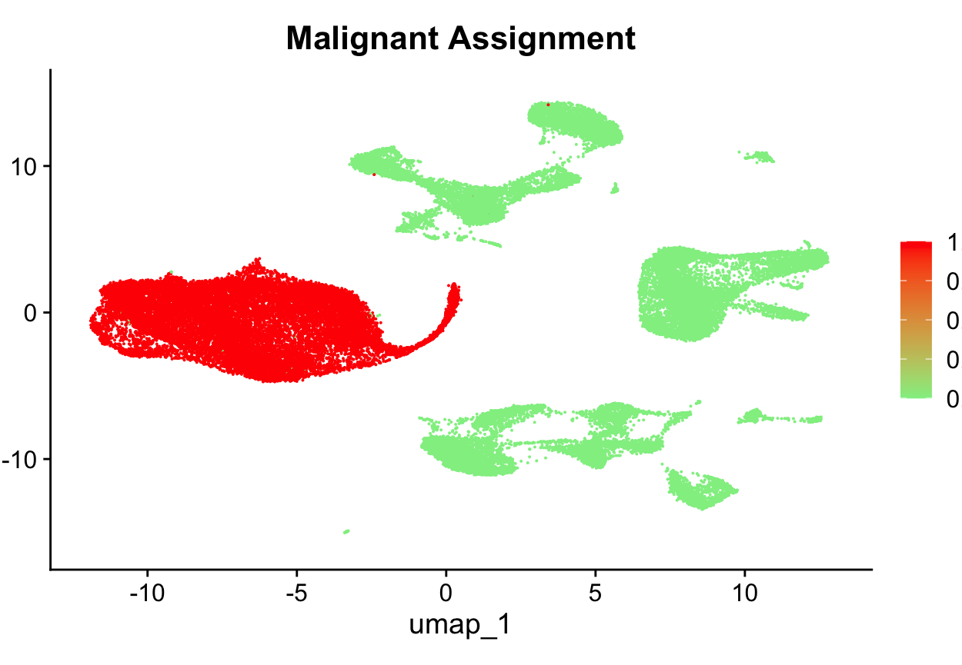

Slide 5
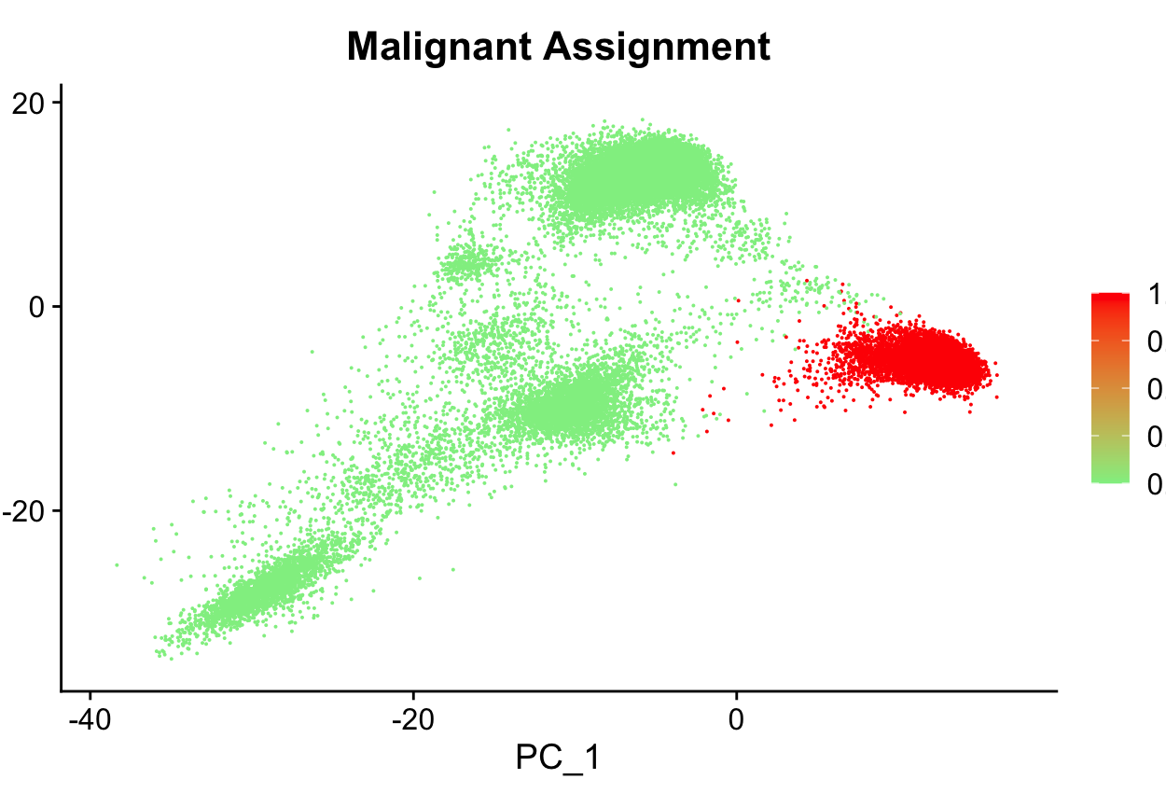

Slide 6
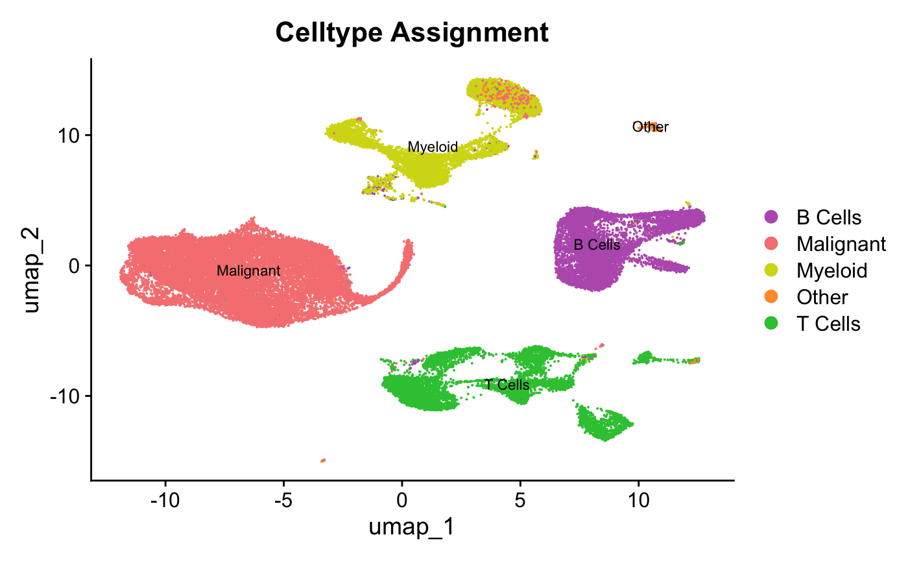

Slide 7
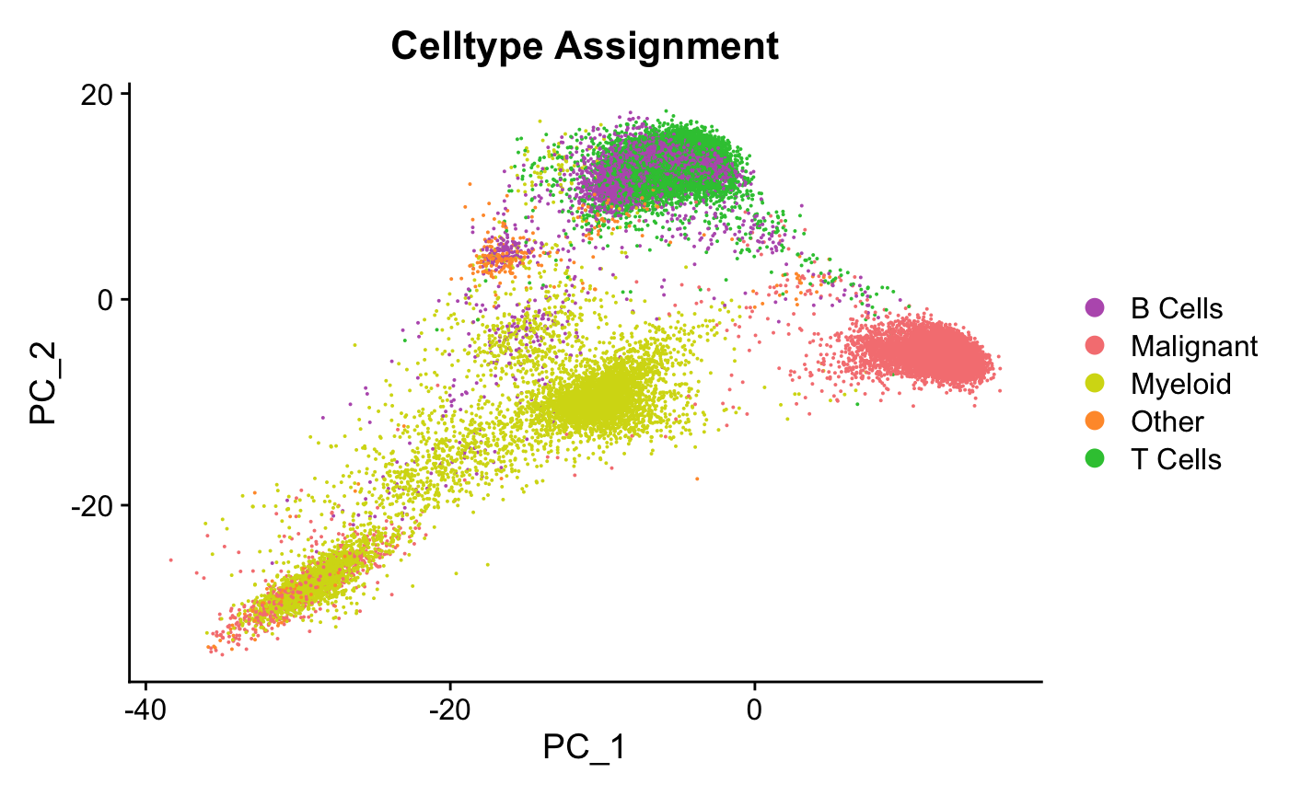

Slide 8
Individual samples

